Slide 1

PETROL PRICE
ANALYSIS
India 2023 – 2024 · Power BI Dashboard Project
10,000+
20
16
41
7
Records
Cities
States
DAX Measures
Report Pages
Navdeep Kaur (2420478) · BTech CSE IOT · CGC University Mohali
Notes:
Title slide — introduce yourself and the project overview.

Slide 2




01 / PROBLEM STATEMENT
Problem
Why This Analysis Matters
Four core challenges in understanding Indian petrol prices
Frequent Price Fluctuations
Global Factor Impact
Petrol and diesel prices in India change almost daily, making it difficult for consumers and businesses to plan fuel expenses effectively.
Rising crude oil prices and rupee depreciation against USD directly increase fuel costs, but the exact impact across cities remains unclear.
City-wise Price Inequality
Seasonal Demand Patterns
Petrol prices vary significantly across cities and states due to different state tax structures, transportation costs, and dealer commissions.
Festival seasons and weekends may influence demand and pricing, but these patterns have never been systematically analyzed for Indian cities.
Petrol Price Analysis · India 2023–2024 · Navdeep Kaur (2420478) · CGC University Mohali

Slide 3


02 / DATASET OVERVIEW
Dataset
About the Dataset
Daily petrol & diesel price records across 20 Indian cities — Jan 2023 to Dec 2024
Dataset Details
Key Columns in Dataset
Source
Synthetic daily fuel price records
Date, City, State
Petrol_Price_INR, Diesel_Price_INR
Period
Jan 2023 – Dec 2024
Crude_Oil_USD, Exchange_Rate_USD_INR
Records
10,000 rows
Tax_Percentage, Dealer_Commission
Cities
20 Indian cities
Transportation_Cost, Inflation_Rate
Demand_Index, Supply_Index
States
16 Indian states
Vehicle_Density, Population_Millions
Format
CSV — petrol_price.csv
Festival_Season, Weekend, Trend_Label
Petrol Price Analysis · India 2023–2024 · Navdeep Kaur (2420478) · CGC University Mohali

Slide 4
03 / DATA PREPARATION
Data Prep
Data Cleaning & Preparation
6 key steps taken before building any visual in Power BI
01
Star Schema Design
02
Data Type Fixing
03
Relationship Building
Split flat CSV into 1 Fact + 5 Dimension tables: Dim_City, Dim_Economic, Dim_Trend, Dim_Season, DateTable.
Date columns → Date type. Price columns → Decimal Number. ID columns → Whole Number in Power Query Editor.
5 relationships created in Model View connecting Fact table to all Dimension tables via foreign keys.
04
Sort Order Correction
05
41 DAX Measures
06
Date Table Setup
Month sorted by MonthNo (Jan→Dec). Weekday sorted by WeekdayNo (Mon→Sun). State/City set as geographic data categories.
Custom measures: averages, YoY/MoM growth, rolling 7-day avg, volatility, rankings, seasonal premiums, demand-supply gap.
DateTable marked as official Date Table enabling all time intelligence DAX: SAMEPERIODLASTYEAR, TOTALYTD, DATEADD.
Petrol Price Analysis · India 2023–2024 · Navdeep Kaur (2420478) · CGC University Mohali

Slide 5
04 / DATA MODEL
Model
Star Schema Data Model
Professional data architecture connecting 6 tables with 5 One-to-Many relationships
DIMENSION
DIMENSION
DIMENSION
Dim_Economic
Dim_Trend
DateTable
FACT TABLE
Eco_ID · Crude_Oil
Exchange Rate
Trend_ID
Rising · Falling · Stable
Date · Month
Quarter · Weekday
Fact_Petrol_Price
DIMENSION
Petrol_Price_INR · Diesel_Price_INR
DIMENSION
Dim_Season
Dim_City
Tax_% · Demand_Index · Supply_Index
Season_ID
Festival · Weekend
City_ID · City
State
Price_Change_% · Dealer_Commission
Transportation_Cost · Vehicle_Density
All relationships: One-to-Many (1 : *) · Direction: Dimension → Fact Table · Cross-filter: Single
Petrol Price Analysis · India 2023–2024 · Navdeep Kaur (2420478) · CGC University Mohali

Slide 6

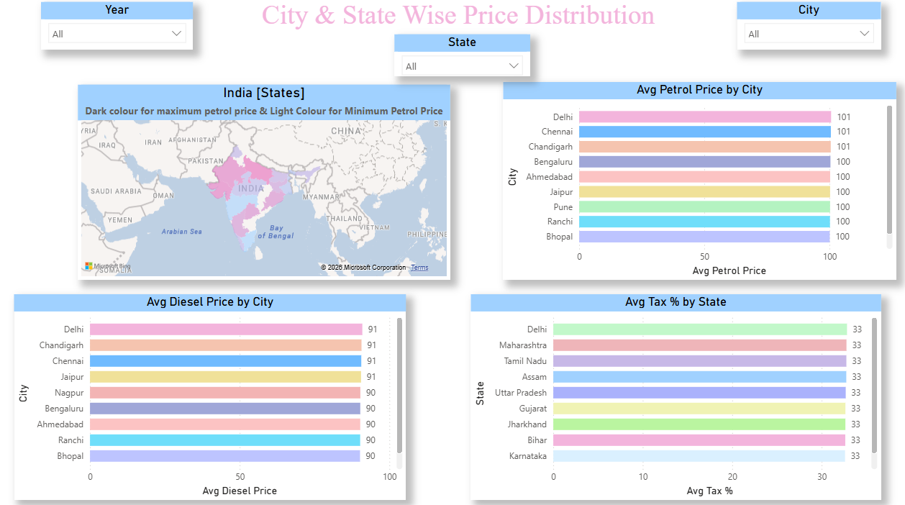



05 / GEOGRAPHIC ANALYSIS
Geographic
City & State Price Distribution
Mapping petrol price inequality across 16 Indian states and 20 cities
State-wise Filled Map
Paste your Power BI screenshot here →
All 16 states colored by Avg Petrol Price. Darker = costlier. Click any state to filter all page charts instantly.
📊
Top 10 Cities by Price
Horizontal bar chart sorted descending with Top N filter. Data labels show exact price per city.
Tax % by State
States with highest VAT on fuel identified. State tax is the single biggest domestic price driver.
[ Insert your Power BI Map + Top Cities Bar Chart screenshot here ]
Petrol vs Diesel Gap
DAX measure: Avg Petrol − Avg Diesel. Diesel is consistently cheaper across all 20 cities.
Petrol Price Analysis · India 2023–2024 · Navdeep Kaur (2420478) · CGC University Mohali

Slide 7
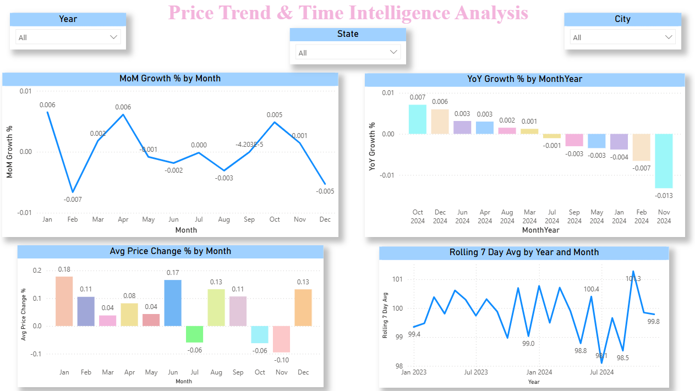



06 / PRICE TRENDS
Price Trends
Price Trend & Time Intelligence
Monthly patterns, YoY/MoM growth, and rolling averages using DAX time intelligence functions
YoY Growth %
Paste your Power BI screenshot here →
SAMEPERIODLASTYEAR compares each month to the same month last year. 2024 vs 2023 movement.
📊
MoM Growth %
DATEADD with -1 MONTH offset tracks short-term month-to-month price movement.
Rolling 7-Day Avg
DATESINPERIOD smooths daily spikes revealing the true underlying price trend direction.
[ Insert your Power BI Monthly Line Chart + YoY Column Chart screenshot here ]
Price Volatility by Month
It shows which month had the most Price Swing.
Petrol Price Analysis · India 2023–2024 · Navdeep Kaur (2420478) · CGC University Mohali

Slide 8

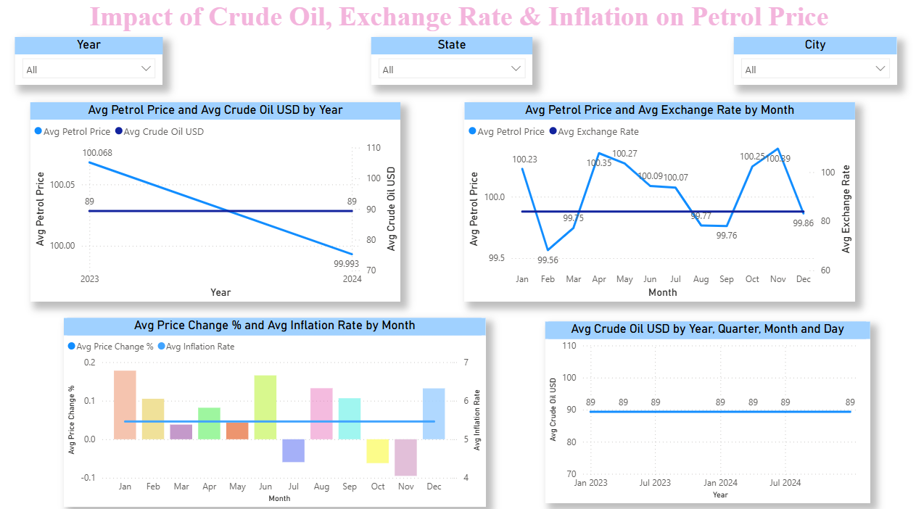


07 / ECONOMIC FACTORS
Economic
Impact of Economic Factors
How global crude oil prices, exchange rates, and inflation drive domestic petrol costs
Crude Oil vs Petrol
Paste your Power BI screenshot here →
Dual-axis line chart shows clear positive correlation. Crude oil spike → petrol price rise within year.
📊
Exchange Rate Impact
Line chart shows: weaker rupee (higher USD/INR) → costlier crude imports → higher petrol prices.
Inflation Correlation
Combo chart compares monthly inflation rate with price change %. Both move in the same direction.
[ Insert your Power BI Crude Oil Dual-Axis Chart + Exchange Rate Chart screenshot here ]
Crude Cost Price Trend
Standalone crude oil movement over time.
Petrol Price Analysis · India 2023–2024 · Navdeep Kaur (2420478) · CGC University Mohali

Slide 9

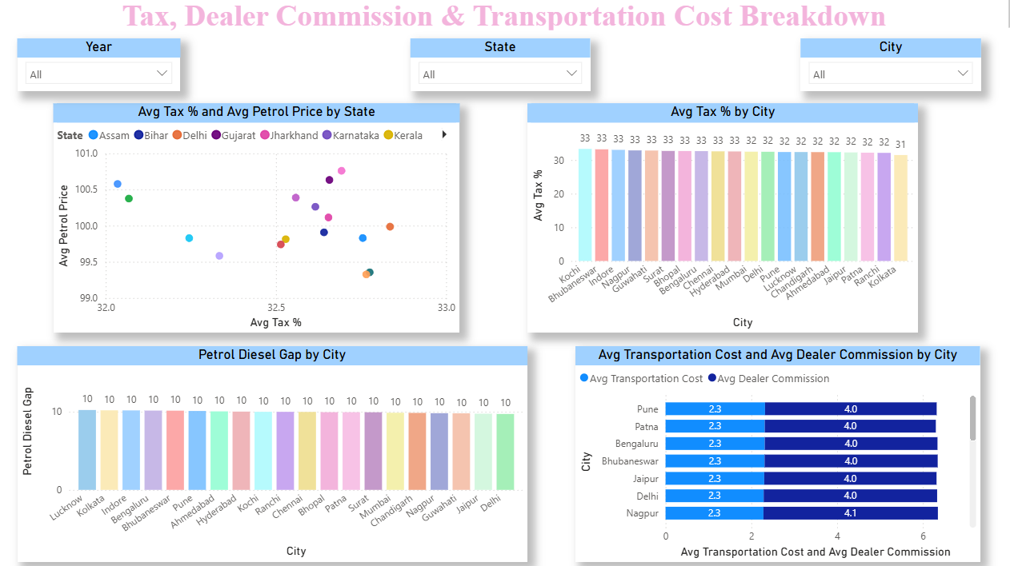



08 / COST ANALYSIS
Cost
Cost Breakdown & Tax Analysis
Decomposing petrol price into tax, dealer commission, transportation cost, and base price
Tax % Scatter Chart
Paste your Power BI screenshot here →
Scatter of Tax_% (X) vs Petrol_Price (Y) by state. Trendline confirms: higher tax = higher price.
📊
Cost Stacked Bar
Stacked bar: Avg Dealer Commission + Avg Transportation Cost per city side by side.
Tax % by City
Bar chart sorted descending — reveals which city impose the heaviest fuel tax burden.
[ Insert your Power BI Tax Scatter Chart + Stacked Bar Chart screenshot here ]
Petrol–Diesel Gap
Diesel is consistently ₹8–12 cheaper than petrol across all cities — shown per city in a column chart.
Petrol Price Analysis · India 2023–2024 · Navdeep Kaur (2420478) · CGC University Mohali

Slide 10

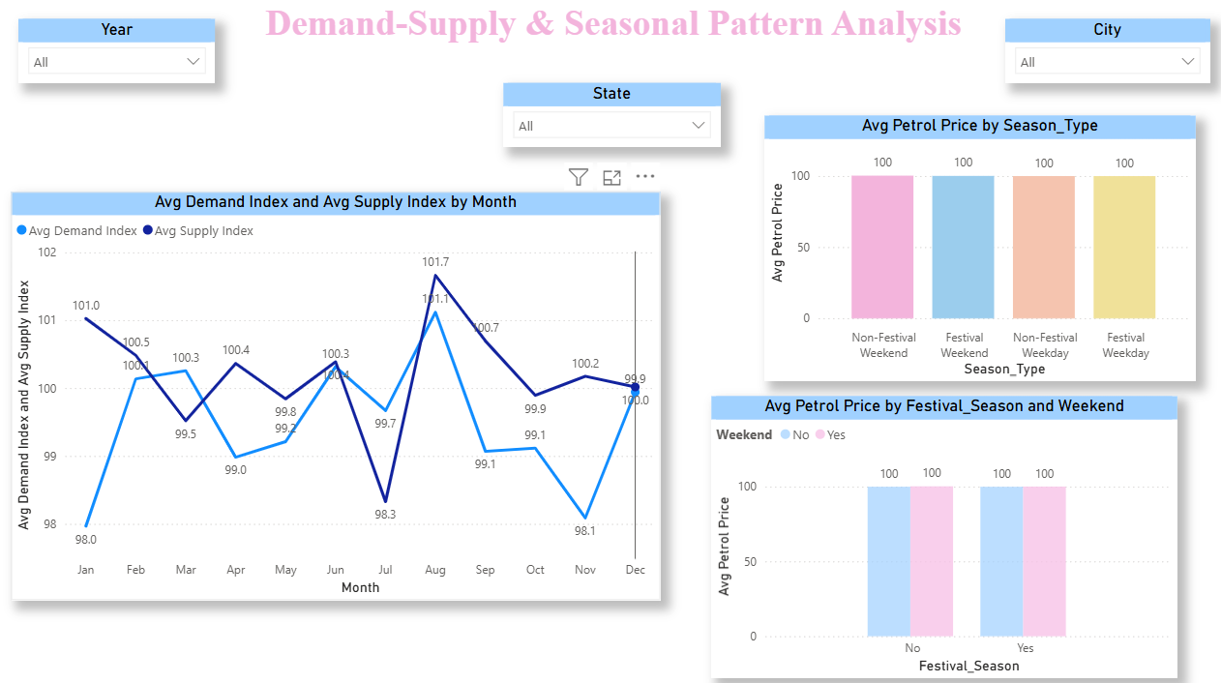



09 / SEASONAL & DEMAND
Seasonal
Seasonal Patterns & Demand-Supply
Festival season premiums, weekend pricing, day-of-week patterns, and demand-supply gap analysis
Festival Season Premium
Paste your Power BI screenshot here →
Festival weekends show highest Avg Price. DAX: Avg Price(Festival) − Avg Price(Non-Festival) = premium in ₹.
📊
Weekend vs Weekday
Weekend Price Premium measure quantifies exact difference. Clustered column chart with Legend = Weekend field.
Day of Week Pattern
Column chart using DateTable[Weekday] sorted Mon–Sun. Reveals which day consistently has cheapest petrol.
[ Insert your Power BI Festival Bar Chart + Demand-Supply Line Chart screenshot here ]
Demand–Supply Gap
Demand_Index − Supply_Index measure. Positive = demand exceeds supply = upward price pressure that month.
Petrol Price Analysis · India 2023–2024 · Navdeep Kaur (2420478) · CGC University Mohali

Slide 11

Findings
Key Findings
Tax is the #1 domestic driver
01
City prices vary ₹8–10 per litre
Crude oil & petrol move together
01
02
~35% of petrol price is state VAT. High-tax states show consistently higher prices regardless of global crude movement.
Geographic analysis reveals significant inter-city gaps driven by transportation costs, dealer margins, and state taxes.
Dual-axis chart confirms positive correlation — every crude spike is followed by a petrol rise within 1–2 months.
Rupee depreciation raises costs
Festival seasons push prices higher
03
04
Demand-supply gap signals price
04
As USD/INR exchange rate rises (rupee weakens), crude import costs increase — directly pushing petrol prices up.
Festival Premium DAX measure confirms petrol is priced higher during festivals, especially on festival weekends.
Months with Demand Index > Supply Index show upward price pressure — demand-supply dynamics are measurable.
Petrol Price Analysis · India 2023–2024 · Navdeep Kaur (2420478) · CGC University Mohali

Slide 12
11 / CONCLUSION
Conclusion
Conclusion & Learnings
What this project achieved and what I learned
Project Summary
This Power BI project analysed 10,000 daily petrol price records across 20 Indian cities from January 2023 to December 2024. A professional Star Schema data model was built from a flat CSV, 41 DAX measures were created, and 28 interactive visuals were deployed across 7 report pages to deliver insights on pricing patterns, economic correlations, geographic disparities, and seasonal behaviour.
Star Schema design makes Power BI faster and more flexible than a single flat table
DAX measures are more powerful than Excel formulas — they update automatically with every filter click
Relationships between tables are the foundation of every meaningful visual in Power BI
Data visualization turns raw numbers into clear stories that anyone can understand instantly
Indian petrol prices are driven by a combination of global (crude, exchange rate) and local (tax, demand) factors
Petrol Price Analysis · India 2023–2024 · Navdeep Kaur (2420478) · CGC University Mohali

Slide 13
Thank You!
for your attention
Name
Student ID
Program
University
Navdeep Kaur
2420478
BTech CSE IOT
CGC Mohali
Open to Questions & Feedback
Petrol Price Analysis · Power BI Dashboard Project · India 2023–2024

